Slide 1
Physical Database Design Issues, Storage of Database on Hard Disks, File Organization and its Type
Name : Rupak Sarkar Roll No.: 14271024036 Stream : MCA Semester : Semester 1st Subject : Relational Database Management System Subject Code : MCAN-102

Slide 2
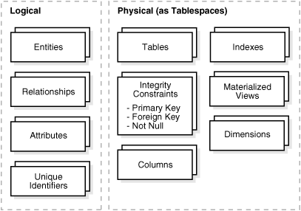
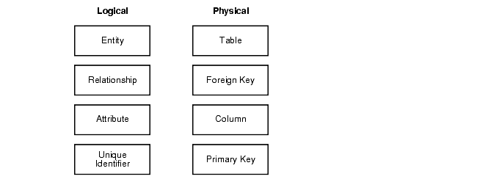
Physical Database Design Issues.
Physical database design focuses on implementing a database structure on a specific hardware and software platform. Effective design is crucial for achieving optimal performance, efficient storage utilization, and ease of maintenance. However, several common challenges must be addressed.

Slide 3
Storage Allocation
Issue: Inefficient allocation of disk space may lead to underutilized resources or frequent storage expansion.
Solution: Estimate the data size accurately and account for growth by considering the number of rows, index sizes, and auxiliary storage needs.
2. Indexing Problems
Issue: Over-indexing can slow down data modification operations (INSERT, UPDATE, DELETE), while under-indexing can cause slow query performance.
Solution: Carefully analyze query patterns and create only the necessary indexes, including primary and foreign key indexes.
3. Fragmentation
Issue: Frequent updates and deletions can cause table or index fragmentation, reducing performance.
Solution: Use tools like rebuild indexes and table defragmentation utilities periodically.

Slide 4
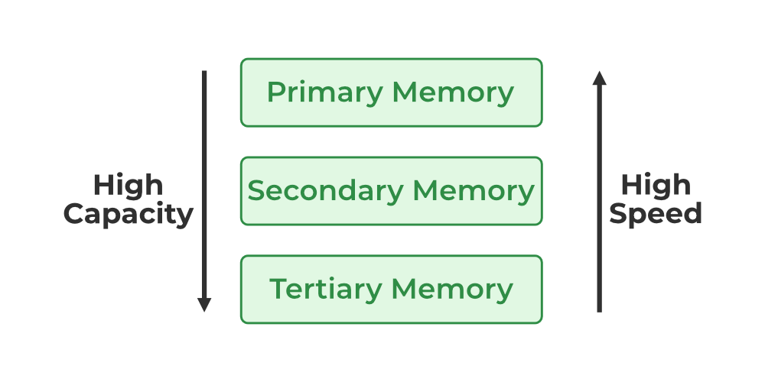
Storage of Database on Hard Disks
Primary Memory
Secondary Memory
Tertiary Memory
Primary Memory
The primary memory of a server is the type of data storage that is directly accessible by the central processing unit, meaning that it doesn’t require any other devices to read from it.
Secondary Memory
Data storage devices known as secondary storage, as the name suggests, are devices that can be accessed for storing data that will be needed at a later point in time for various purposes or database actions.
Tertiary Memory
For data storage, Tertiary Memory refers to devices that can hold a large amount of data without being constantly connected to the server or the peripherals.

Slide 5
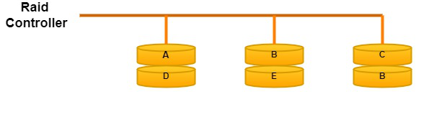
Magnetic Disks
Present-day computer systems use hard disk drives as secondary storage devices. Magnetic disks store information using the concept of magnetism.
Redundant Array of Independent Disks(RAID)
In the Redundant Array of Independent Disks technology, two or more secondary storage devices are connected so that the devices operate as one storage medium.
RAID 0:
At this level, disks are organized in a striped array. Blocks of data are divided into disks and distributed over disks.

Slide 6
File Organization and its Type
What is File Organization?
Logical relationships among various records that constitute the file with respect to specific record.
The Objective of File Organization
It helps in the faster selection of records i.e. it makes the process faster.
Different Operations like inserting, deleting, and updating different records are faster and easier.
It prevents us from inserting duplicate records via various operations.
It helps in storing the records or the data very efficiently at a minimal cost.

Slide 7
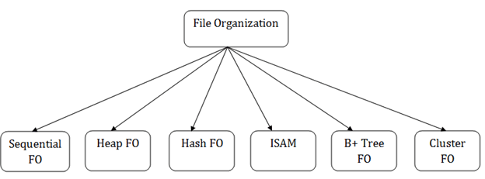
Types of File Organizations
Various methods have been introduced to Organize files. These particular methods have advantages and disadvantages on the basis of access or selection. Thus it is all upon the programmer to decide the best-suited file Organization method according to his requirements.
Some types of File Organizations are:
Sequential File Organization
Heap File Organization
Hash File Organization
B+ Tree File Organization
Clustered File Organization
ISAM (Indexed Sequential Access Method)

Slide 8
Thank You!

